Slide 1
Subsection Module
Interfaces
Interface | Information Required | Information Returned
createSubsections | Print Job Configuration Object | Modified Print Job Configuration Object
External Data Dependencies
Data | Source
Subsectioned STL files | OpenSCAD Executable
Internal Data Descriptors
Data | Source
PrintJobConfiguration object | PrintJobController

Slide 2
Subsection Module (cont.)
Data Required from Print Job Configuration
Parent STL Files in each subsection
Bottom Z for each subsection
Top Z for each subsection
Data Modified in Print Job Configuration
Subsection STL Files for each subsection

Slide 3
Subsection Module (cont.)
Testing
Given a Print Job Configuration Object containing the bottom z, top z, and Parent STL files for each subsection, the Subsection Module will create new Subsection STL files (sub-sectioned by z = bottom z and z = top z planes) for each Parent STL file and store the reference to the created Subsection STL files back into the Print Job Configuration Object.

Slide 4
File Translation Module
Interfaces
Interface | Information Required | Information Returned
translateFiles | Print Job Configuration Object | Modified Print Job Configuration Object
External Data Depenedencies
None
Internal Data Descriptors
Data | Source
PrintJobConfiguration object | PrintJobController

Slide 5
File Translation Module (cont.)
Data Required from Print Job Configuration
Subsection STL Files for each subsection
Materials of each STL File for each subsection
Data Modified in Print Job Configuration
AMF File for each subsection

Slide 6
File Translation Module (cont.)
Testing
Given the Print Job Configuration Object containing the Subsection STL files for each subsection as well as the materials for each STL file, the File Translation Module will translate these files into a correct AMF File for each subsection.

Slide 7
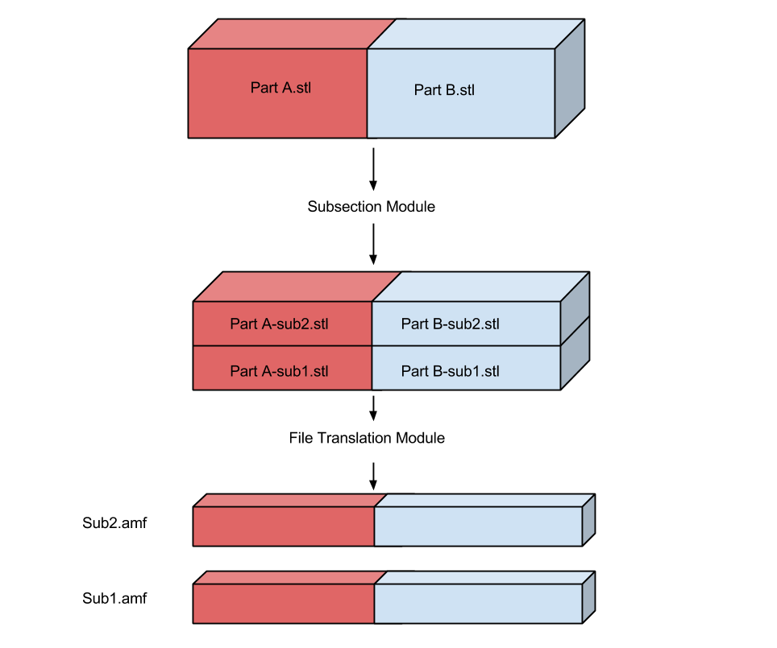
Object Lifecycle

Slide 8
Slicing Engine Wrapper Module
Interfaces
Interface | Information Required | Information Returned
GenerateGCode | Print Job Configuration Object | Modified Print Job Configuration Object
External Data Dependencies
Data | Source
G-Code files | Slic3r Slicing Engine
Internal Data Descriptors
Data | Source
PrintJobConfiguration object | PrintJobController

Slide 9
Slicing Engine Wrapper (cont.)
Required Data from Print Job Configuration
For each subsection, all data elements from the following classes:
InfillConfiguration
LayerAndPerimeterConfiguration
SpeedConfiguration
SkirtAndBrimConfiguration
SupportMaterialConfiguration
For each file in each subsection, all data elements from the following classes:
MaterialConfiguration
ExtruderConfiguration
The following data elements from the PrinterConfiguration class:
bedX
bedY
printCenterX
printCenterY
zOffset
gCodeFlavor
useRelativeEDistances
vibrationLimit
Data Modified in Print Job Configuration
G-Code files for each subsection

Slide 10
Slicing Engine Wrapper Module (cont.)
Testing
Given a Print Job Configuration Object with all required data elements the Slicing Engine Wrapper will run the Slic3r slicing engine to produce a G-Code file for each subsection and place a reference to each G-Code file into the Print Job Configuration Object.

Slide 11
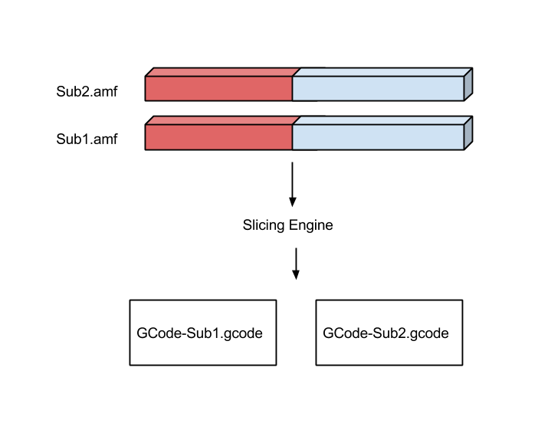
Object Lifecycle

Slide 12
Parser Module
Interfaces
Interface | Information Required | Information Returned
parseAndModifyGCode | Print Job Configuration Object | Modified Print Job Configuration Object
External Data Dependencies
None
Internal Data Descriptors
Data | Source
PrintJobConfiguration object | PrintJobController

Slide 13
Parser Module (cont.)
Required Data from Print Job Configuration
G-Code files for each subsection
Printer G-Code flavor
Custom print start/end G-Code
Data Modified in Print Job Configuration
G-Code files for each subsection

Slide 14
Parser Module (cont.)
Testing
Given a Print Job Configuration Object with all required data elements the Parser Module will modify or delete any unacceptable G-Codes found any G-Code files.

Slide 15
Unification Module
Interfaces
Interface | Information Required | Information Returned
unifyGCode | Print Job Configuration Object | Modified Print Job Configuration Object
External Data Dependencies
None
Internal Data Descriptors
Data | Source
PrintJobConfiguration object | PrintJobController

Slide 16
Unification Module (cont.)
Required Data from Print Job Configuration
G-Code files for each subsection
Data Modified in Print Job Configuration
Finalized Print Job G-Code file

Slide 17
Unification Module (cont.)
Testing
Given a Print Job Configuration Object with all required data elements the Unification Module will concatenate all Subsection G-Code files into a single Finalized G-Code file and place a reference to the finalized G-Code file into the Print Job Configuration Object.

Slide 18
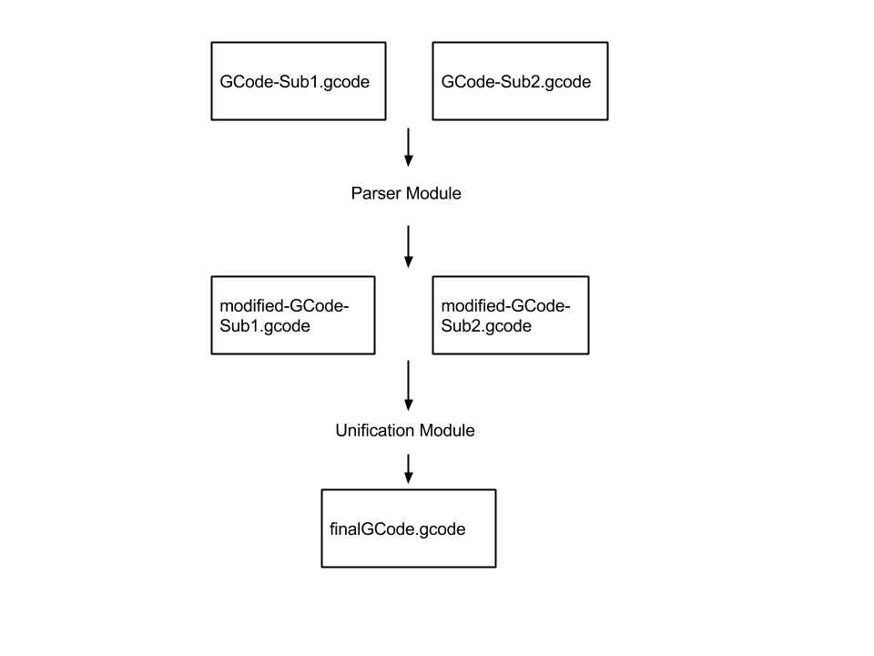
Object Lifecycle

